Slide 1



IS Team Updates
November 22nd
Hosted by the Java Team:
Alan Hummel
Alex Basaric
Douglas Marques
Mihir Maniar
Olga Agady
Ryan Do

Slide 2
Today Schedule
Speaker | Subject | Time
Java member | Welcome | 5 minutes
John Hynes | Welcome, team | 10 minutes
Connie Liu | Presenting new team member | 1 minute
Alan Hummel | Using Git | 10 minutes
Olga Agady | Integration with Box.com | 5 minutes
Anita Wong | FMS Upgrade Update | 5 minutes
Sammy Douglas | Destruction Update | 5 minutes
Senthil/Melissa | Digitalization Team Update | 10 minutes
Patrick | UCS | 5 minutes
Donovan | MFA | 5 minutes
Sanjay | TBD | 10 minutes
Andrew | RA | 5 minutes

Slide 3
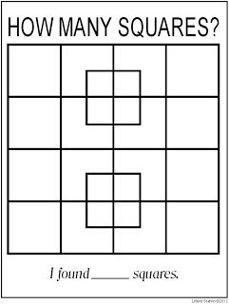

Slide 4
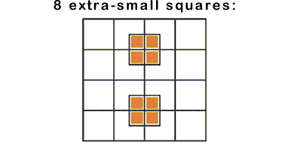
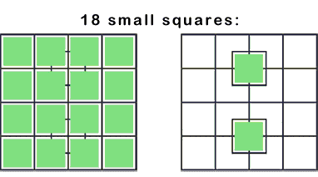
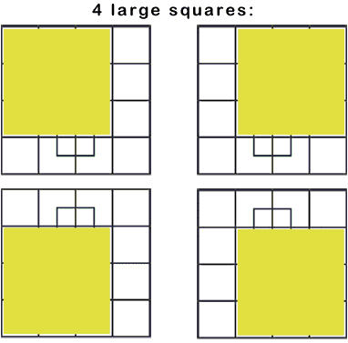
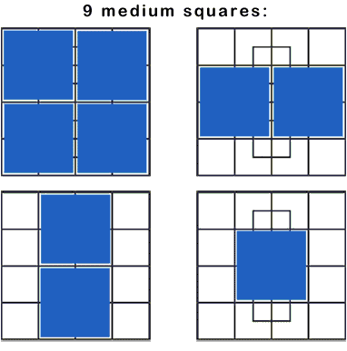
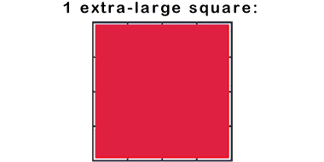


Slide 5
Basic Version Control and Git
General Idea
Alan Hummel
alan.hummel@tarion.com

Slide 6

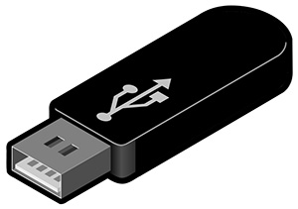
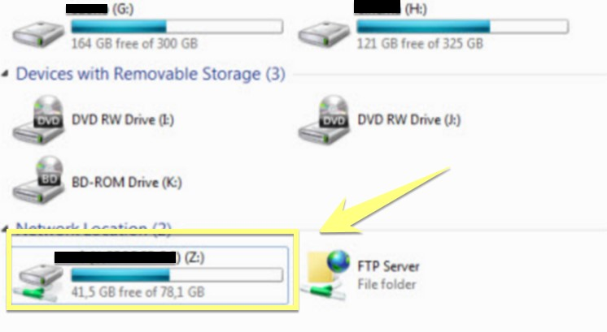
Sharing Documents and Projects
Notes:
- Opposing to a file system.

Slide 7
What is a version control system?
Is a software that helps software developers to work together and maintain a complete history of their work.
It is useful for:
Allowing developers to work simultaneously.
Not allowing overwriting other developers changes.
Maintaining a history of every version.
Notes:
- Opposing to a file system.

Slide 8

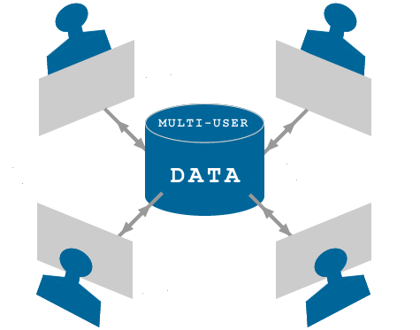
Version Control System
Based on repositories
It is a multi-user system
Notes:
Each repository represents a “Project”.
You should only commit changes after you attain a “stable” result.

Slide 9

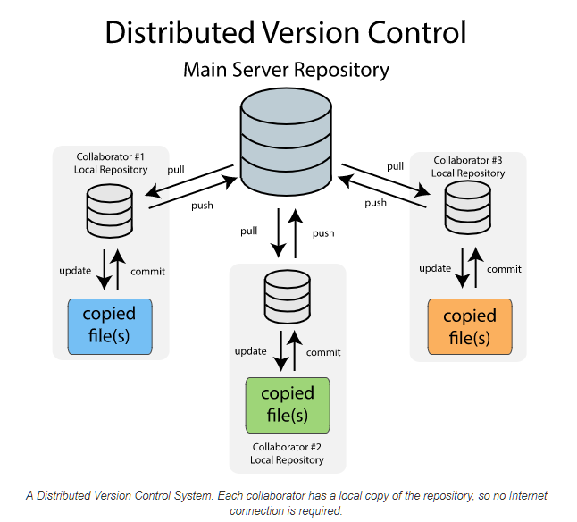
Notes:
- Each collaborator has his/her own repository.
Developers can work off-line on their own sandboxes and commit whenever they want it to.
And push only after they attain a desirable result.
Advantages vs the “non-distributed” are:
That you can take as many “snapshots” and commits you want, being that stable or not.
Reduces the iterations of mistakes committed into the main server repository.

Slide 10
Distributed Version Control System
Local fully mirrors a Remote repository.
Can work off-line.
Allow the creation of branches (On-line or Off-line).
Allow checking logs (On-line or Off-line).

Slide 11

Advantages of using Git
It’s faster for branching.
It is secure (SHA-1 cryptography).
Lightweight. (Doesn’t require a lot of processing power)
Free and Open Source.

Slide 12
Git Terminologies
Local Repository.
Working Directory and Staging Area or Index.
Working Directory
Git add operation
Staging Area
Git commit operation
Git Repository

Slide 13
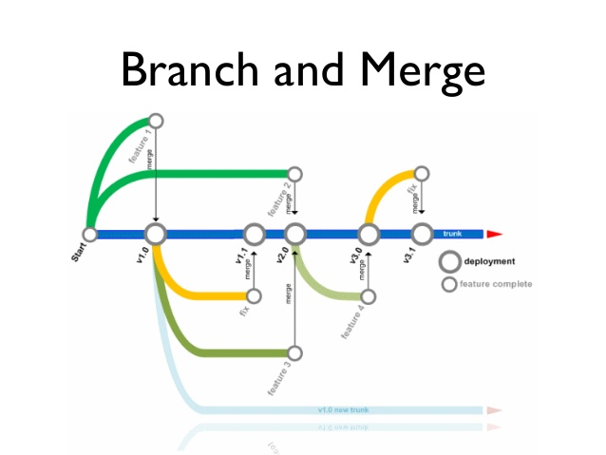
Git Terminologies / Representations
Tags
Commits
Branches
HEAD
Master / Trunk
Merge
Notes:
- Each commit is a new “snapshot”.
Each of these “features” are “branches” in a version control/GIT.
The “newest” commit in a branch is the HEAD of that branch.
Each of this versions are “Tags”. (Immutable)

Slide 14
Git Terminologies / Remote
Pull
Push
Clone
Notes:
- Remote Repository Operations

Slide 15
Git Routine
Remote add (share) / Clone
Working Copy
Update
Modify working copy
Review changes
Push
Modify working copy
Push
Fix mistakes
Notes:
You clone the Git repository as a working copy. Remote add (share on Katalon) is done only the first time when you’re creating the project at the repository at the first time. The first time you’re cloning the repository (assuming you’re not the person who added it). After you clone it, you’ll have a Working Copy at your machine.
You Update (pull), taking other developers changes.
You modify the working copy by ADDING/EDITING or DELETING files.
Review the changes before committing
Commit the changes if everything is fine, changes go into repository.
After committing something is wrong, you can either correct the errors by merging commits on the same file, or push to the remote repository or return to modifying the working copy until it is okay.

Slide 16

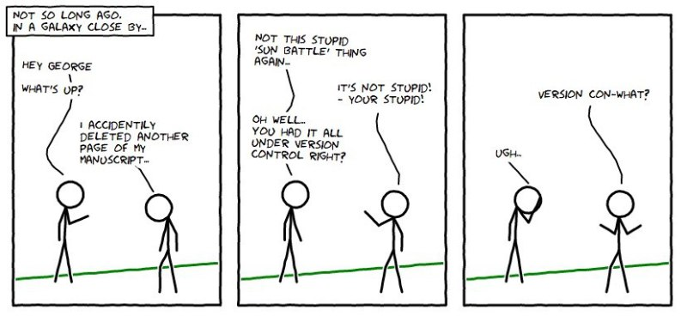

Slide 17
Integration with Box.com
Olga Agady
olga.agady@tarion.com
My Home doesn’t allow to upload documents over 25MB
Large documents need to be approved before being uploaded to CN
Approvals and uploading to CN need to be automated

Slide 18


Integration with Box.com
3. Box sends notification to
a Tarion user that the file is waiting for approval
2. My Home uploads
the file to Box
Box.com
My Home
4. Tarion user
approves the file
1. Home owner uploads a large file to My Home
5. Tip is running a job which checks for approved files.
Tarion user
TIP
Home owner
6. Approved files are
uploaded to CM
Content Manager

